Slide 1

Panther: Fast Top-K Similarity Search on Large Networks
Jing Zhang¹, Jie Tang¹, Cong Ma¹, Hanghang Tong²,
Yu Jing¹, and Juanzi Li¹
¹Department of Computer Science and Technology
Tsinghua University
²School of Computing, Informatics, and Decision Systems Engineering
Arizona State University

Slide 2
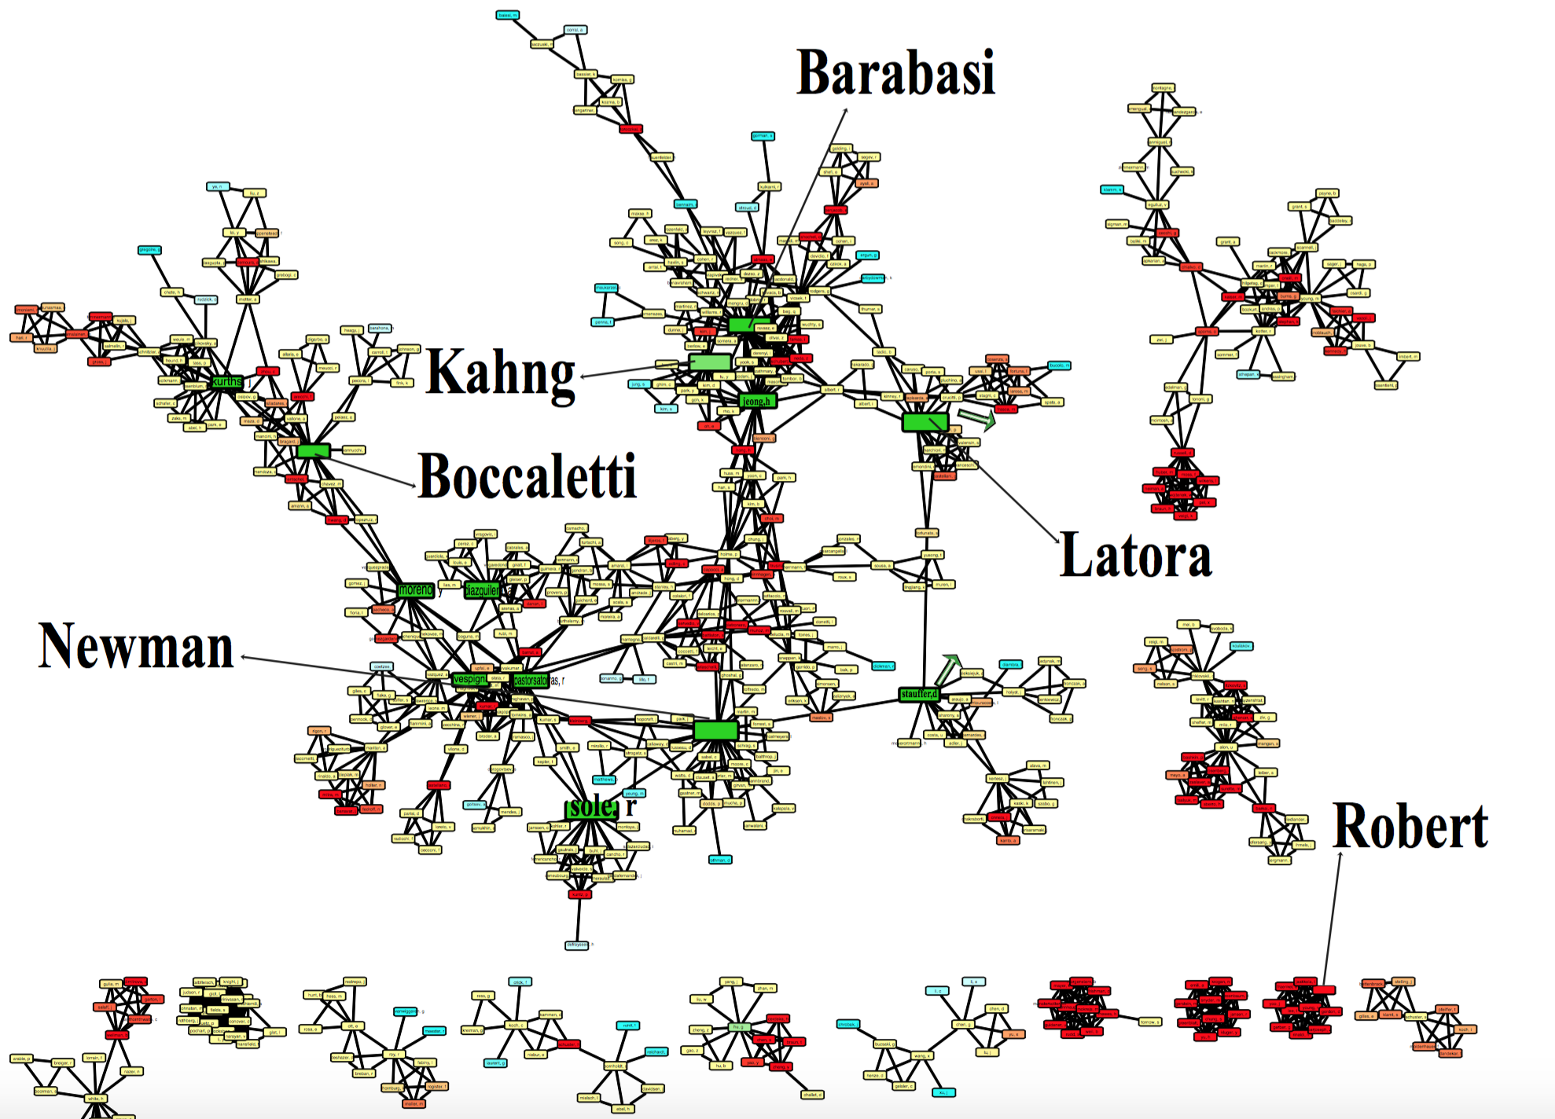
Who are Similar with Barabási?

Slide 3

Similar Authors in Aminer

Slide 4
Related Work and Challenges
1
Method | Time Complexity | Space Complexity
SimRank [kdd’02] | O(IN²d²) | O(N²)
TopSim [ICDE’12] | O(NTd^{T}) | O(N+M)
RWR [KDD’04] | O(IN²d) | O(N²)
RoleSim [KDD’11] | O(IN²d²) | O(N²)
ReFex [KDD’11] | O(N+I(fM+Nf²)) | O(N+Mf)
Share many direct/indirect common neighbors.
2
Disconnected, but share similar structure.
Find top-K similar vertices for any vertex in a network
d: average degree, f: feature number, T: path length
Challenges
C1 : How to design a similarity method that applies to both similarities?
C2: Computational efficiency challenge.

Slide 5
Our Approach: Panther

Slide 6
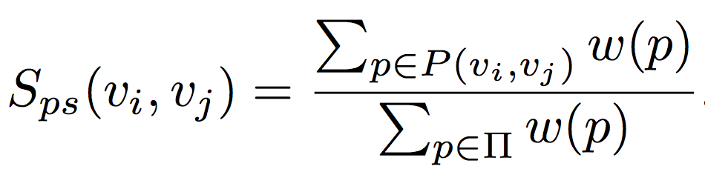
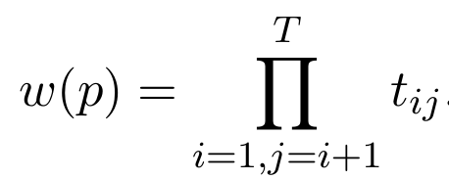
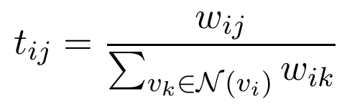
Path Similarity
1
Intuition: two vertices are similar if they frequently appear on the same paths.
v₂
v₃
v₁
v₅
v₄
(T=2)
A path is a T-length sequence of vertices p = (v₁,··· ,v_{T+1}).
Π is all the T-paths in G.
Path weight:
S_{ps}(v_{1,}v₂)=0.37, S_{ps}(v_{1,}v₃)=0.42,
S_{ps}(v_{1,}v₄)=0.39,
S_{ps}(v_{1,}v₅)=0.09.

Slide 7
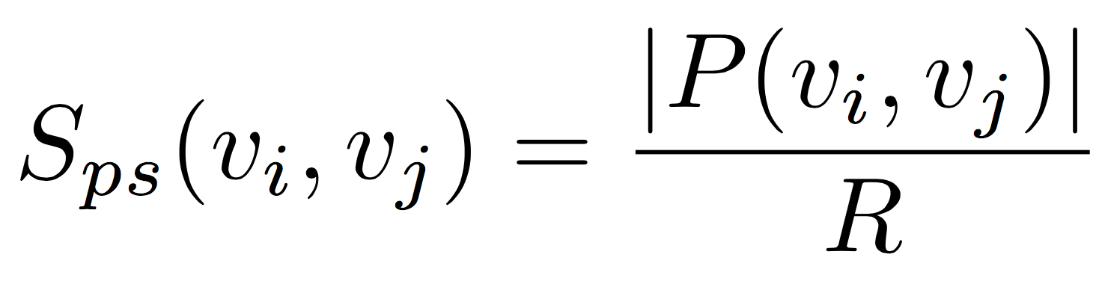
Panther_{ps}
Basic idea: random path sampling
Simplified path similarity:
O(RT)
O(dT)

Slide 8
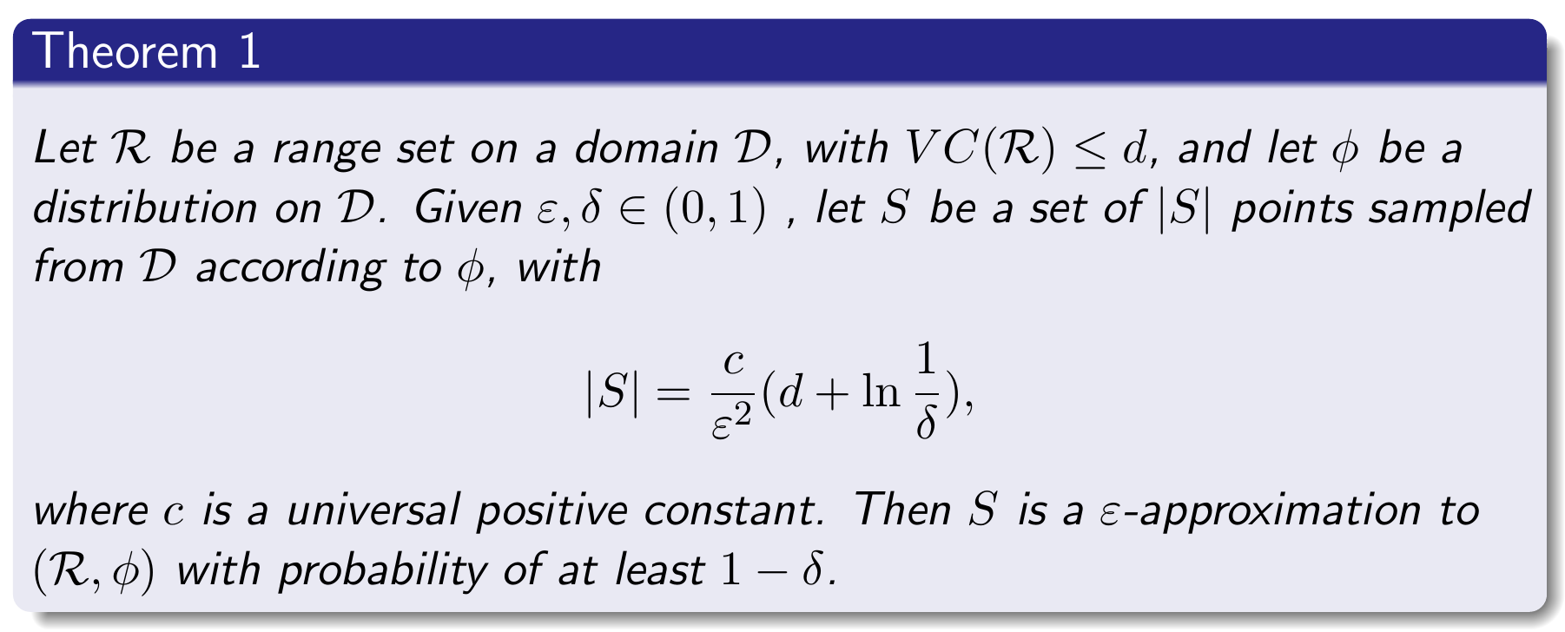
Theoretical Analysis
How many random paths shall we sample?
Domain and range set
Upper bound of range set’s VC dimension
Distribution
1
2
3
Required sample size

Slide 9
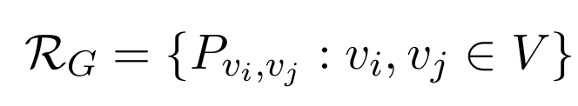
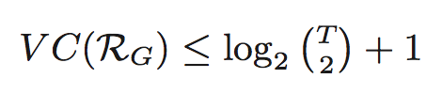
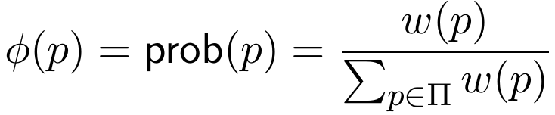
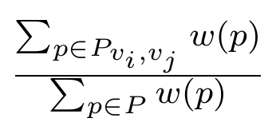
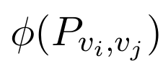
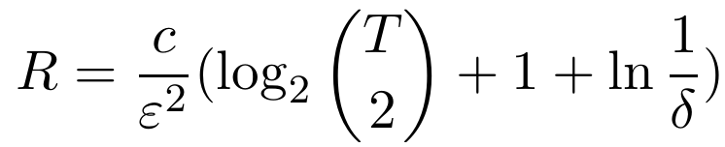
Theoretical Analysis
Details
Domain: Π
Range set:
VC bound:
Distribution:
Path similarity is
Conclusion
R random paths can guarantee ε and 1−δ.

Slide 10
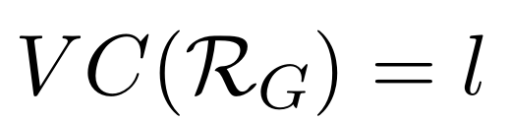
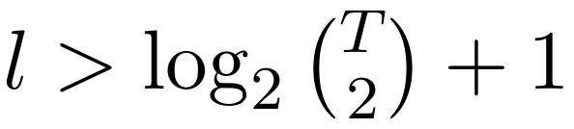
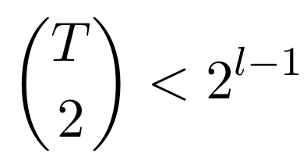
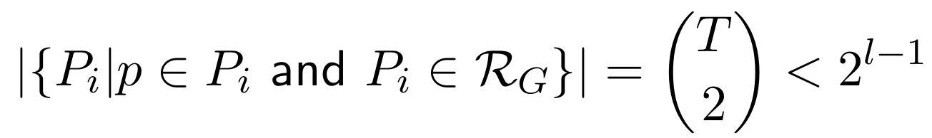
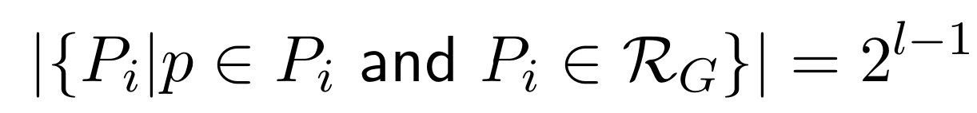
Proof of
Details
Assume
and
A set Q of size l can be shattered by R_{G}
A 1-1 corresponding between each subset in Q and each range P_{i} in R_{G}
A path belongs only to the ranges w.r.t a pair of vertices in the path
Contradiction

Slide 11
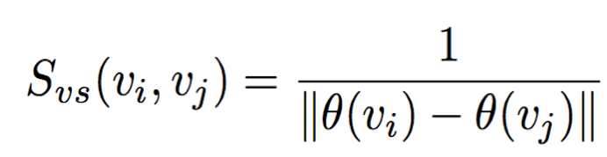
Vector Similarity and Panther_{vs}
2
Limitation of path similarity: bias to close neighbors.
Vector Similarity: the probability distributions of a vertex linking to all other vertices are similar if their topology structures are similar.
Panther_{vs} :Use top-D path similarities calculated by Panther_{ps} to represent a vector:
0.13
0.13
0.04
0
0
0
0.12
v
0.12
(T=2)
0.13 | 0.13 | 0.04 | 0 | 0 | 0
0.39
u
0.12
0.12
0.11
0.02
0
0.12
0.25
w
0.12
0.39 | 0.12 | 0.12 | 0.12 | 0.12 | 0.12
0.12
S_{vs}(u,w)=0.27 > S_{vs} (u,v)=0.16
0.25 | 0.12 | 0.12 | 0.11 | 0.02 | 0

Slide 12
Time Complexity
Method | Time Complexity | Space Complexity
SimRank | O(IN²d²) | O(N²)
TopSim | O(NTd^{T}) | O(N+M)
RWR | O(IN²d) | O(N²)
RoleSim | O(IN²d²) | O(N²)
ReFex | O(N+I(fM+Nf²)) | O(N+Mf)
Panther_{ps} | O(RTc+NdT) | O(RT+Nd)
Panther_{vs} | O(RTc+NdT+Nc) | O(RT+Nd+ND)
Random path
Vertex-to-path index
Kd-tree
Random path sampling
Top-k similarity search for any vertex
Build and query kd-tree

Slide 13
Experiments

Slide 14
Evaluation Aspects
Efficiency Performance
Accuracy Performance
Parameter Sensitivity Analysis

Slide 15
Efficiency Performance
Tencent network
Preprocessing time + top-k similarity search time
|V| | |E| | RWR [(KDD’04] | TopSim [ICDE’12] | RoleSim [KDD’11] | ReFex [KDD’11] | Panther_{ps} | Panther_{vs}
6,523 | 10,000 | +7.79hr | +38.58m | +37.26s | 3.85s+0.07s | 0.07s+0.26s | 0.99s+0.21s
25,844 | 50,000 | +>150hr | +11.20hr | +12.98m | 26.09s+0.40s | 0.28s+1.53s | 2.45s+4.21s
48,837 | 100,000 |  | +30.94hr | +1.06hr | 2.02m+0.57s | 0.58s+3.48s | 5.30s+5.96s
169,209 | 500,000 |  | +>120hr | +>72hr | 17.18m+2.51s | 8.19s+16.08s | 27.94s+24.17s
230,103 | 1,000,000 |  |  |  | 31.50m+3.29s | 15.31s+30.63s | 49.83s+22.86s
443,070 | 5,000,000 |  |  |  | 24.15hr+8.55s | 50.91s+2.82m | 4.01m+1.29m
702,049 | 10,000,000 |  |  |  | >48hr | 2.21m+6.24m | 8.60m+6.58m
2,767,344 | 50,000,000 |  |  |  |  | 15.787m+1.36hr | 1.60hr+2.17hr
5,355,507 | 100,000,000 |  |  |  |  | 44.09m+4.50hr | 5.61hr+6.47hr
26,033,969 | 500,000,000 |  |  |  |  | 4.82hr+25.01hr | 32.90hr+47.34hr
51,640,620 | 1,000,000,000 |  |  |  |  | 13.32hr+80.38hr | 98.15hr+120.01hr
270X speed up
390X speed up
Can scale up to handle 1 billion edges
T=5, c=0.5, ε=√1/|E| and δ=0.1, R=16,609,640

Slide 16
Accuracy Performance of Panther_{ps}
Evaluate how Panther_{ps} can approximate common neighbors.
The score represents the improvement over a random method.
KDD
Twitter
Mobile
Co-author networks: |V|=3K, |E| = 7K.
Twitter network: |V| = 100K, |E| = 500K.
Mobile network: |V| = 200K, |E| = 200K.

Slide 17
Accuracy Performance of Panther_{vs}
Identity Resolution
Assume the same authors in different networks of the same domain are similar to each other.
Settings
Given any two co-author networks, e.g., KDD and ICDM, if the top-k similar vertices from ICDM consists of the query author from KDD, we say that the method hits a correct instance.
KDD-ICDM
SIGIR-CIKM
SIGMOD-ICDE

Slide 18
Parameter Analysis: Path Length T
The performance gets better when T increases.
The performance almost becomes stable When T ≥ 5.
KDD
Mobile
Twitter
Effect of path length T on the accuracy performance of Panther_{ps}.

Slide 19
Parameter Analysis: Error Bound ε
Tencent sub networks
Panther_{ps}
When |E|/(1/ε)² ranges from 5 to 20, scores of Panther_{ps} are almost convergent.
The value (1/ε)² is almost linearly positively correlated with the number of edges in a network.

Slide 20
Conclusion
Methods:
Solve two similarity metrics efficiently.
Theoretic analysis:
Sampling size is only related to path length given error-bound and confidence level.
Empirical evaluations:
When |V| = 0.5 million and |E|=5 million, Panther_{ps} achieves a 390× speed-up and Panther_{vs} achieves a 270x speed-up.
Panther can scale up to a network with 1 billion edges.

Slide 21
Thank You Code & Data: http://aminer.org/Panther

